Slide 1
Crowd Counting
Aaditya Gole
Daksh Rajesh

Slide 2
Problem statement
The primary objective of this project is to accurately count the number of people present in a cafe in real-time, while excluding the employees from the count. This involves distinguishing between customers and employees in a dynamic environment using video footage. The challenge is to ensure that the count is stable and accurate, despite the presence of overlapping bounding boxes, flickering counts, and the need to differentiate between customers and employees.

Slide 3
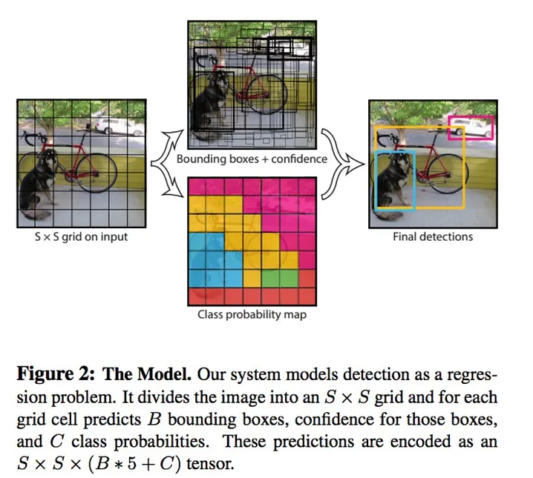
Tools used :yolov8
Using pre trained yolo to detect customers

Slide 4
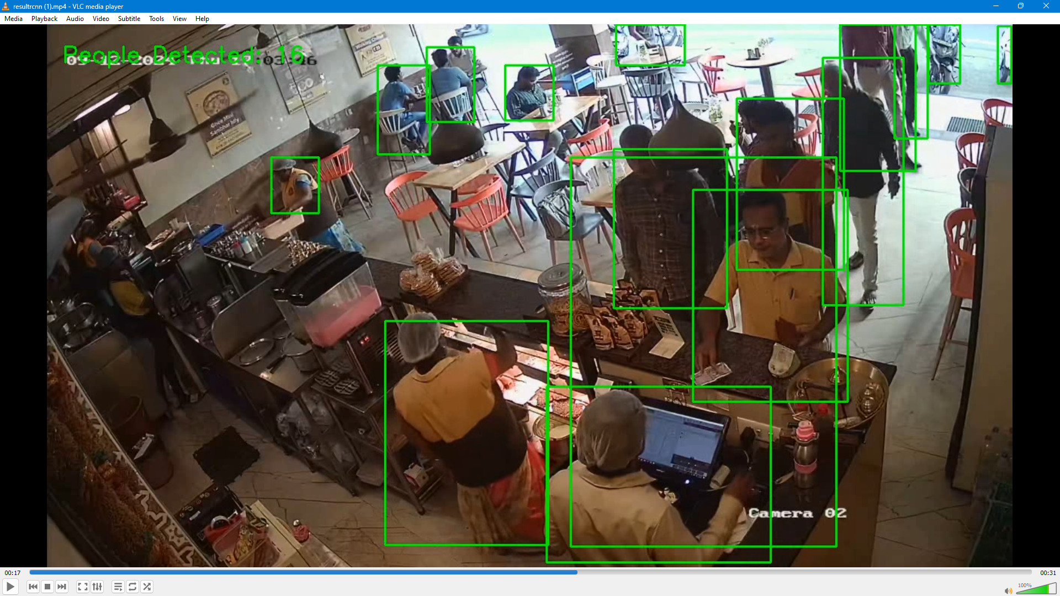
Version 1.0

Slide 5
Version 1.0
Problems:
Multiple detections for same object
Rapid detection and non-detection (flickering)
Average count fluctuating wildly due to flickering and multiple detection
Detecting employees too

Slide 6
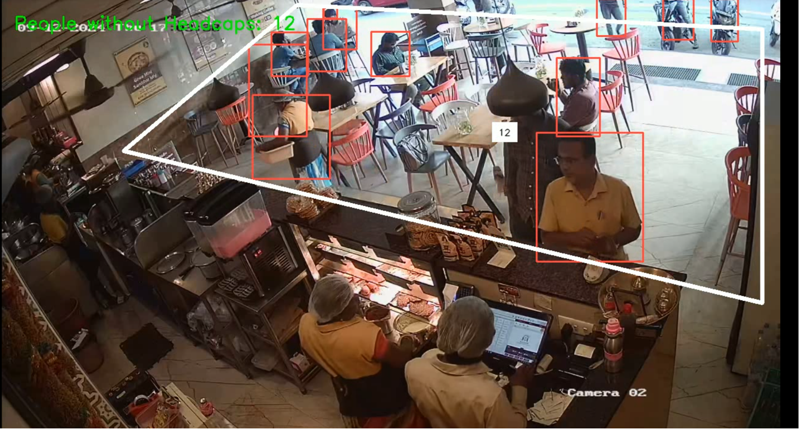
Version 2.0 - polygon
Implementing a “customer zone” where customers are supposed to be

Slide 7
Version 2.0 - polygon
Problems:
Multiple detections for same object
Rapid detection and non-detection (flickering)
Average count fluctuating wildly due to flickering and multiple detection
Detecting employees who now walk into the zone

Slide 8
Version 3.0 – Headcap+suppression
Subtracting customers wearing headcap (solved in a different subproblem) from total count
Using implicit YOLOv8 suppression to take care of multiple boxes for same person
A moving average count of last 10 frames handles fluctuations in the count and negates the flickering of boxes

Slide 9
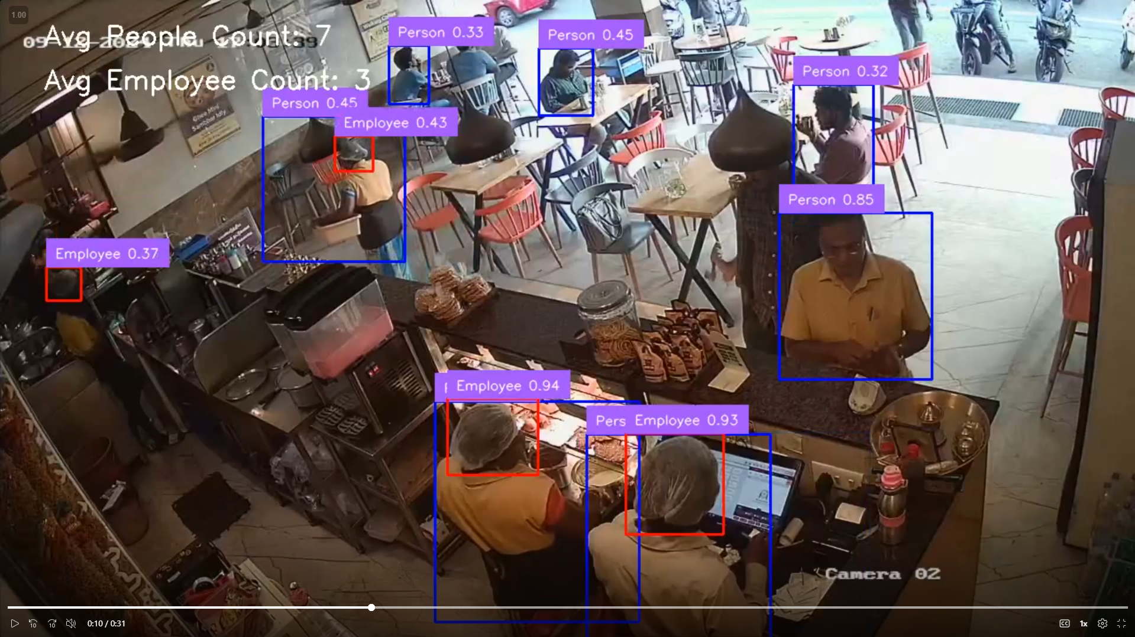
Version 3.0 – Headcap+suppression

Slide 10
Conclusion
These steps have enabled us to confidently count the number of customers in the café at any given moment.
A more detailed and in-depth explanation can be found in our Report
Code and resulting screenshots and videos can be found in our Github and the OneDrive Folder

